Slide 1
Topic 3 – Control Statements (Selection Structures)
VIT 1102 - Introduction to Object Oriented Programming
By Oshadi Alahakoon

Slide 2
VIT1102 - Introduction to Object Oriented Programming
Today’s lecture…
Control Statements in Python
Selection Structures
Boolean Data Type and Comparison Operators
if statement
Multiple if statements

Slide 3
VIT1102 - Introduction to Object Oriented Programming
Control Statements
So far we implemented sequential programming code.
That means when we execute our programs, all the code in the program got executed line by line sequentially.
There are two types of control statements which can change the sequence of running code
Selection structures
- Selects which line of code to run next
Repetition structures (Lecture Week 4)
- Decides how many times to repeatedly run a given line/s of code.

Slide 4
VIT1102 - Introduction to Object Oriented Programming
Today’s lecture…
Control Statements
Selection Structures
Boolean Data Type and Comparison Operators
if statement
Multiple if statements
Output formatting

Slide 5
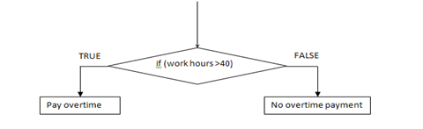
Selection Structures
VIT1102 - Introduction to Object Oriented Programming
Selection structures are used to branch program flow into one or more different paths depending on a condition.
This can be explained using an example diagram as follows.
In the given example depending on the number of work hours, program can take two alternative paths.

Slide 6
VIT1102 - Introduction to Object Oriented Programming
Today’s lecture…
Control Statements
Selection Structures
Boolean Data Type and Comparison Operators
if statement
Multiple if statements
Output formatting

Slide 7

VIT1102 - Introduction to Object Oriented Programming
Boolean Data type
Condition in a selection structure is a Boolean expression.
Boolean data type consists of two values – true or false
In the code segment below (wkHours > 40) is a condition.
The evaluation of the condition is a boolean value.
Condition: evaluates to TRUE if the workhours are grater than 40

Slide 8
VIT1102 - Introduction to Object Oriented Programming
Comparison Operators
In the previous example we used ‘>’ operator.
In a selection condition you can use any of the comparison operators given below.
Operator Sign | Operator Name
< | Less than
> | Greater than
<= | Less than or equal to
>= | Greater than or equal to
== | Equal to
!= | Not equal to

Slide 9
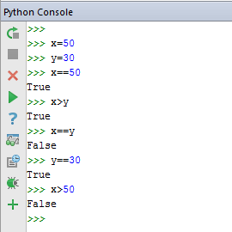
VIT1102 - Introduction to Object Oriented Programming
Evaluating boolean expressions
Example 1
Say x=50 and y=30
x == 50 | True
x > y | True
x == y | False
y == 30 | True
x >50 | False

Slide 10
VIT1102 - Introduction to Object Oriented Programming
Evaluating boolean expressions - Class Exercise
Class Exercise 1
Say x=40 and y=60
Boolean Expression | Value
x == 50
x > y
x != y
y >= 30
x <= 50

Slide 11
VIT1102 - Introduction to Object Oriented Programming
Compound boolean expressions
More than one condition can be used in a selection statement
These conditions can be connected with logical operators: And, Or, Not.
Example 2
and Operator (Say x=50) or Operator (Say x=50)
x == 50 and x < 20 | false
x == 50 and x > 20 | True
x != 50 and x < 20 | False
x != 50 and x > 20 | False
x == 50 or x < 20 | True
x == 50 or x > 20 | True
x != 50 or x < 20 | false
x != 50 or x > 20 | True

Slide 12
VIT1102 - Introduction to Object Oriented Programming
Compound boolean expressions
Class Exercise 2
Assume current weather is; raining and wind is mild. Which of the following compound conditions will return TRUE?
wind == ‘mild’ and rain != ‘yes’
wind == ‘mild’ and rain == ‘yes’
wind != ‘mild’ or rain != ‘yes’
wind != ‘mild’ or rain == ‘yes’

Slide 13
VIT1102 - Introduction to Object Oriented Programming
Compound boolean expressions and Truth tables
Truth tables for logical operators ‘and’ , ‘or’ and ‘not’ are as follows.
and Operator or Operator not Operator
A | B | A and B
True | True | True
True | False | False
False | True | False
False | False | False
A | B | A or B
True | True | True
True | False | True
False | True | True
False | False | False
A | Not A
True | False
False | True

Slide 14
VIT1102 - Introduction to Object Oriented Programming
Today’s lecture…
Control Statements
Selection Structures
Boolean Data Type and Comparison Operators
if statement
Multiple if statements

Slide 15
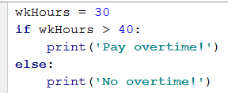
VIT1102 - Introduction to Object Oriented Programming
if – else statements
Code segment below prints a message depending on the number of work hours.
Example 3
Depending on the value in variable wkHours this code will give a different output.
Get executed if the condition is true
Get executed if the condition is false

Slide 16
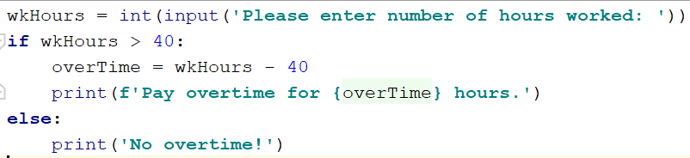
VIT1102 - Introduction to Object Oriented Programming
if – else statement Syntax
Indentation is important to mark a block of code to execute if the condition is true.
Condition terminates with a colon.
Example 4
Indentation

Slide 17
VIT1102 - Introduction to Object Oriented Programming
Today’s lecture…
Control Statements
Selection Structures
Boolean Data Type and Comparison Operators
if statement
Multiple if statements

Slide 18
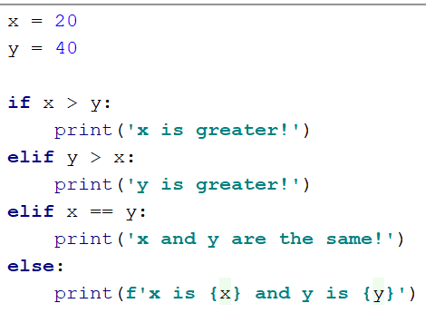
VIT1102 - Introduction to Object Oriented Programming
if – elif - else statement
if-elif-else statements are used when there are more than two selection paths
There can be many ‘elif’ statements between the starting ‘if’ and ending ‘else’
Example 5

Slide 19
VIT1102 - Introduction to Object Oriented Programming
Class Exercise 3
Read two numbers, if the first number is greater than the second, print the difference of the two numbers. If the first number is less than the second, print the addition of the two numbers. Otherwise, print a message saying the two numbers are equal.

Slide 20
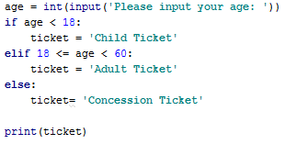
VIT1102 - Introduction to Object Oriented Programming
if – elif - else statement – with an interval
Example 6
Interval Checking

Slide 21
VIT1102 - Introduction to Object Oriented Programming
Example 7
In this exercise, a user enters two test scores for a student. The two scores are added together and then divided by 2. This will provide the average score. Once the average is known then a grade is worked out for that average and is displayed using a print statement.
There are 5 possible grades…..HD, D, C, P and F. Only one of these Grades can be applied to a student.
The average score maps to grades as follows:
80 and above = grade of HD
70 and above = grade of D
60 and above = grade of C
50 and above = grade of P
Below 50 = grade of F

Slide 22
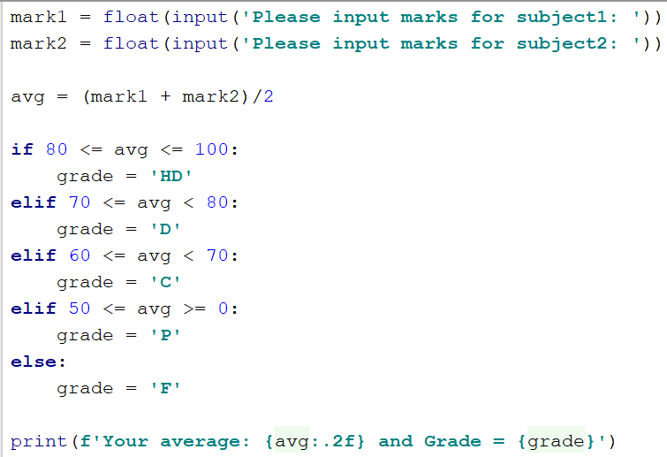
VIT1102 - Introduction to Object Oriented Programming
Class Exercise cont.
Run this code with different inputs to see the output.
Run your program and enter 500 and 600 as the 2 subject scores. What is the outcome?

Slide 23
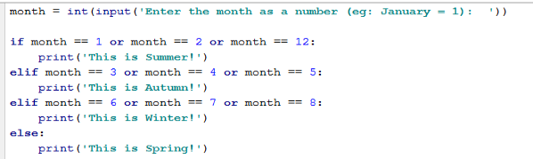
VIT1102 - Introduction to Object Oriented Programming
if – elif - else statement with a compound condition
Using ‘or’ operator
Example 8
There are 3 compound statements in this segment of code using ‘or’ operator

Slide 24
VIT1102 - Introduction to Object Oriented Programming
Class Exercise 5
In this simple exercise, a user can enter the current temperature (in Celsius) and the application will display a message depending on the range the temperature falls into.
If the temperature ranges are:
35+ ………………message to display…….”Go to the Beach – slip, slop, slap
”20+………………. message to display …….”A beautiful day – go outside!!!”
less than 20………. message to display………”Stay inside - time for a DVD”.
Feel free to add more temperature ranges once your program is working correctly.

Slide 25
VIT1102 - Introduction to Object Oriented Programming
Class Exercise 6
New World Drama theater appoints you to write a Python program to calculate price for their drama ticket purchases. There are 3 categories of tickets that customers can order.
Weekends tickets cost $20
Tuesdays $12 and any other weekday $17
Users to provide their day of the drama and the number of the tickets required. Your program should calculate and display the total ticket cost.
Note: Assume a customer always buy tickets for a one performance.

Slide 26
VIT1102 - Introduction to Object Oriented Programming
Lecture Reference
Sweigart, A. (2015). Invent Your Own Computer Games with Python 3rd Edition.

